Slide 1


MEDIA MENGAJAR
BRIGHT AN ENGLISH
FOR SMP/MTs GRADE VIII

Slide 2
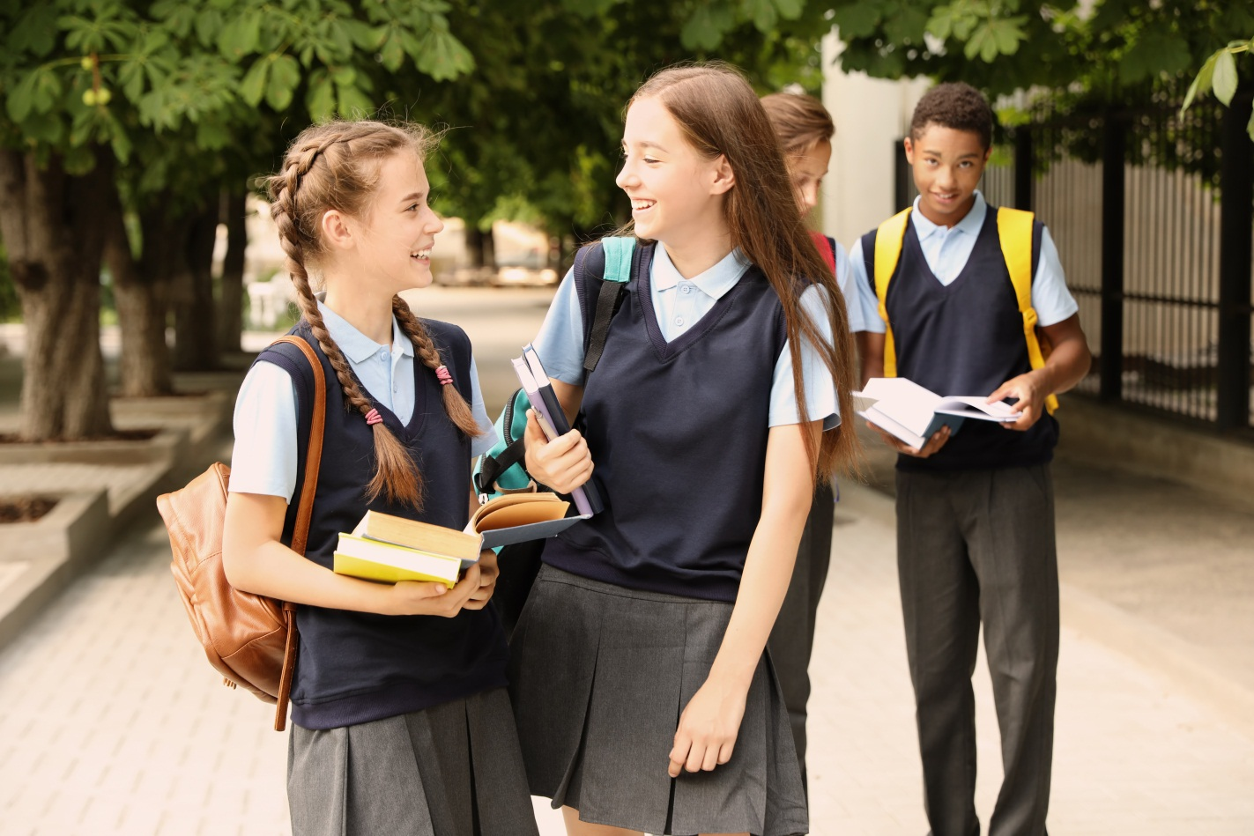
Chapter 6
Let Me Tell You My Story
Notes:
Jika terdapat gambar cantumkan sumber gambar dgn ukuran font 10pt

Slide 3
A. ……….
In this chapter, we will learn to:
identify the simple past and past continuous tense;
use simple past and past continuous tenses in both spoken and written conversation;
analyse the structure of a recount text;
talk about and write experiences;
locate and evaluate main ideas and specific information of recount texts;
communicate ideas and experiences through simple and organised paragraphs.

Slide 4
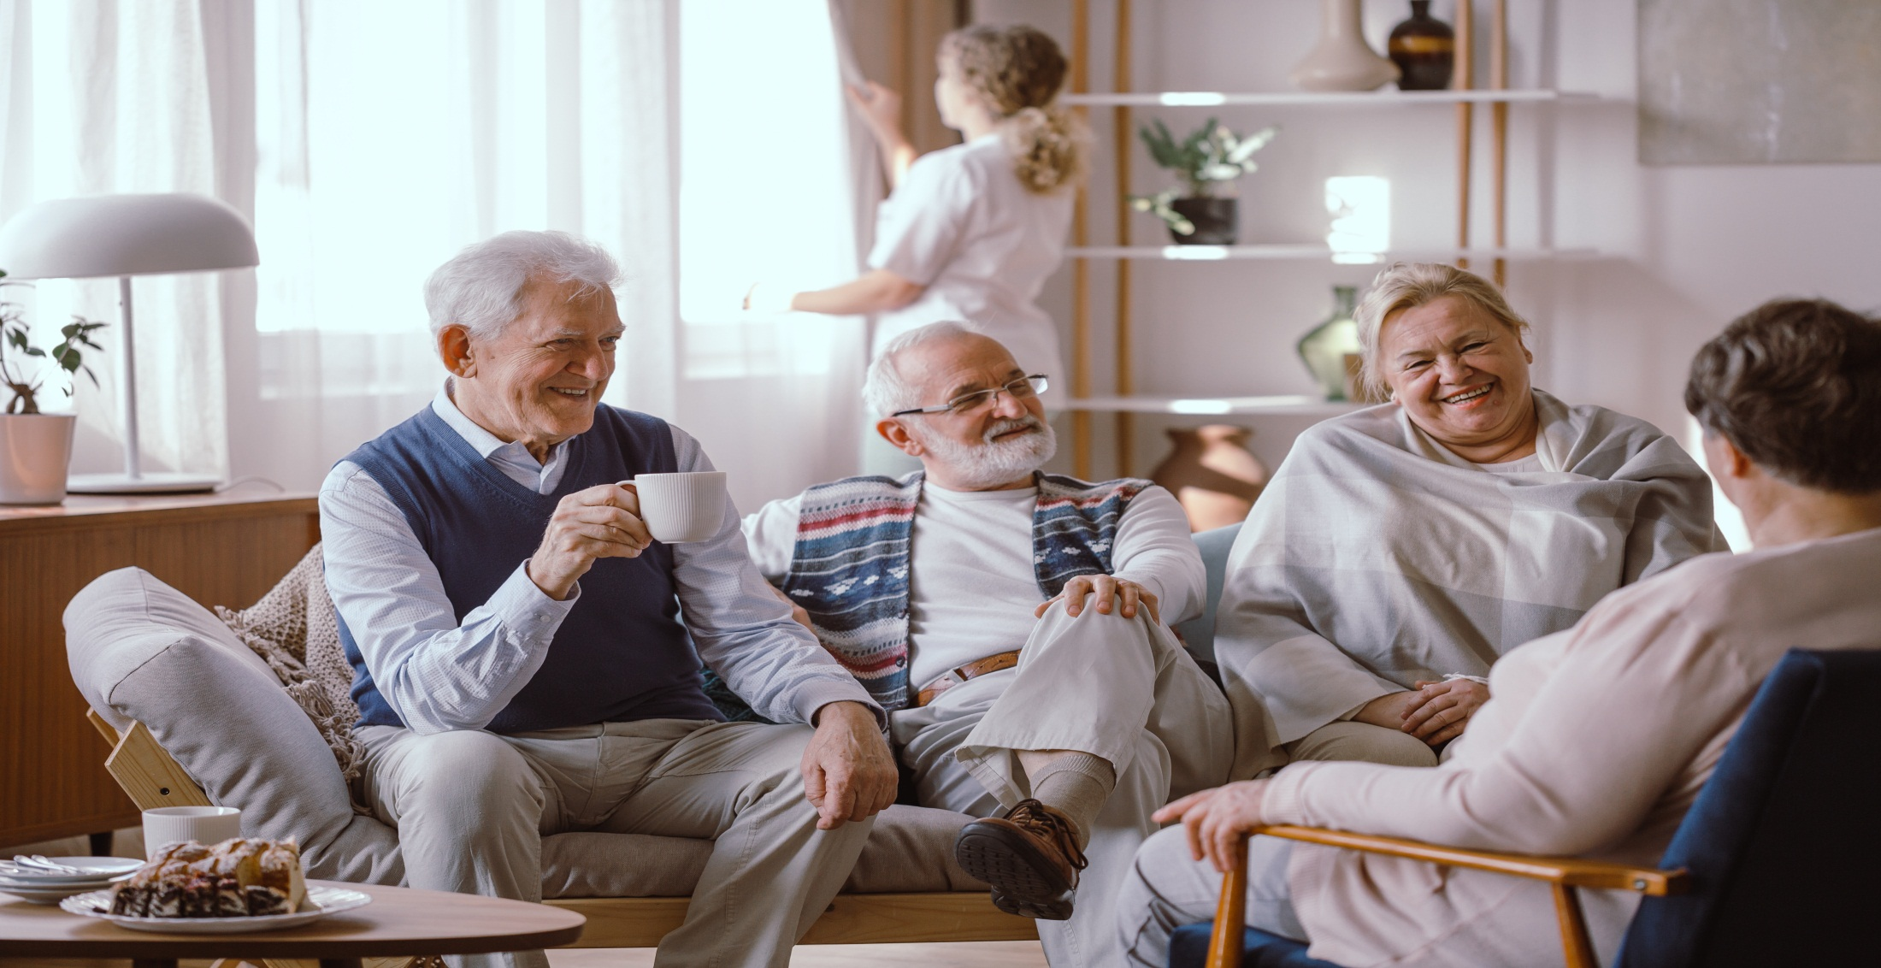
Read the following text.
Last Sunday, my class visited a retirement home in my city. There were twenty five of us, including Mr Stewart, my teacher. We brought with us a keyboard and a guitar. We also brought some snacks specially made for the elderly, and we had little gifts for them too. We arrived at about seven in the morning. Mrs Anisa, the chief of this Home, led us to the hall. We blew up some balloons to decorate the hall. We also cut out chart papers, wrote quotes, and stuck pictures on the wall. We arranged the seats and the tables. We put the snacks and drinks on the tables. Then, we told Mrs Anisa that we were ready. Then in came all the grey-haired sweethearts, some alone, some in pairs, some in groups. They sat in the seats. Mrs Anisa opened the session by giving a short speech introducing us. Then Firman made a speech on our behalf. He told them that we came to have fun with them and to make that day a little more special.
After the speeches were over, Mr Stewart started to play the keyboard and Lia sang an old song. Some of us sang other old songs after that. Some grannies stood up and sang their favourite songs. Some even danced! Then it was time for the gifts and more fun activities. We came to the grannies and handed them our gifts. After that we talked and did activities that they liked. Some of us played chess with the grandpas. Hendrik, who was good at drawing, tried to draw two grandmas. Others were playing guitars and sang songs. I talked to a grandma. She told me that I resembled her grandchild.
We finished our visit at 12 and went home with a sweet memory in our hearts.

Slide 5

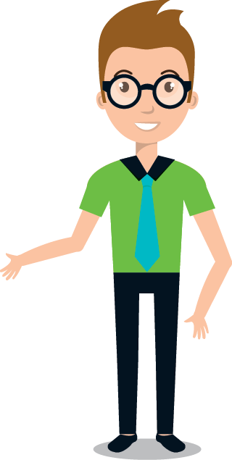
Recount Texts
We make recount text to inform or retell others about something happens to us or to other people.

Slide 6
Most recounts have elements as follows:
An orientation that gives the listener or reader information about the time, the place and those involved.
A series of events recounted as they happened.
A conclusion that gives the writer’s own view of the events and the feelings that aroused of the time.

Slide 7
REVIEW OF SIMPLE PAST & PAST CONTINUOUS TENSES
You use simple past tense to talk about things that happened in the past.
Who invented the television?
We drove to Teluk Penyu beach last weekend.
Was is the simple past for of am and is. You use was with the pronouns I, he, she and it and with singular nouns.
When I was small, I liked dolls.
Was Jack absent from school yesterday?

Slide 8
Were is the simple past for of are. You use were with the pronouns you, we and they, and with plural nouns.
There were dinosaurs in the world, weren’t there?
Were you at the race last week?
You use the past continuous tense to talk about actions that were going on, or happening at a certain moment in the past.
We were taking pictures when a man approached us.
The girls were arguing in the corner.

Slide 9
Connectors of Sequence
In recount texts, we use the connectors of sequence to order events.
Examples:
First, I woke up. Then I took a bath. After that, I caught a bus to school. Next, I learnt a lot of things with my friends at school. Finally, I went home at two in the afternoon.

Slide 10
Adverbs of Time
In a recount text we will find adverbs of time. They tell us when an event happened.
These are some adverb of time to show past events.
yesterday, on Monday, last holiday, last week, two weeks ago, last year, that Sunday, yesterday morning, etc.
Example: - We woke up very early last Saturday.
- Last holiday, I had an excursion to Bogor Botanical Garden.

Slide 11
A paragraph is a group of sentences about one main idea.
A topic sentence is a sentence that tells the main idea of a paragraph. The topic sentence is usually the first sentence in a paragraph.
Sentences with supporting details give more information about the main idea of a paragraph.
Each sentence should contain details that support the topic sentence.

Slide 12
GOOD JOB!

